Slide 1
How does a computer “compute”?
Suhas K Viswanath

Slide 2
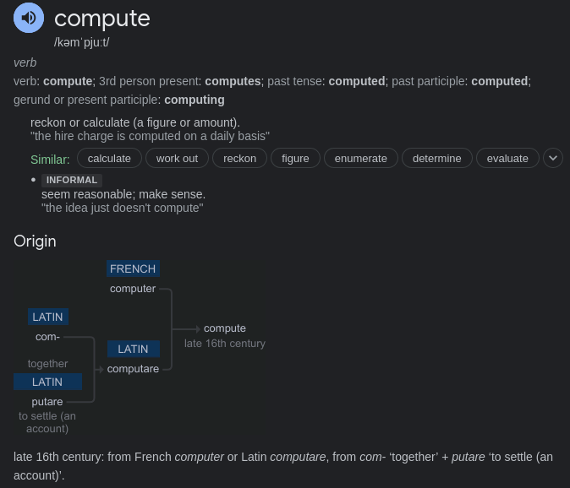
Why are computers called “computers”?

Slide 3
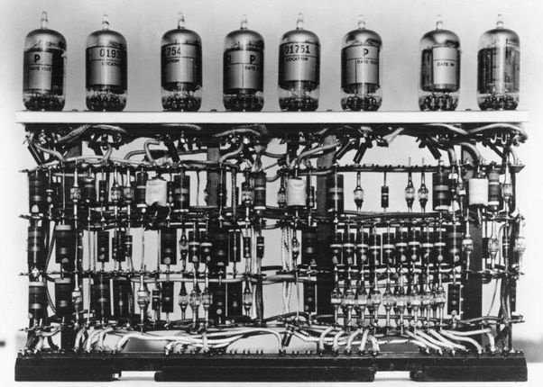
What is this?

Slide 4
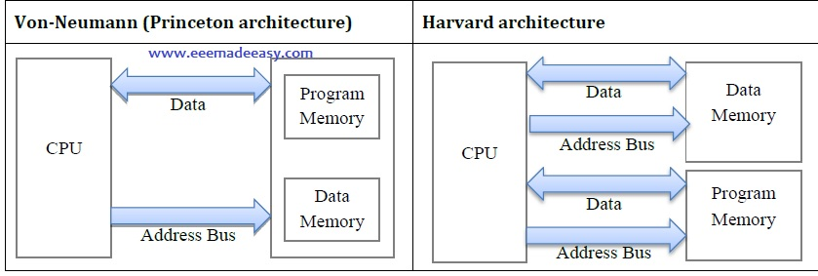
New age computers and computation

Slide 5
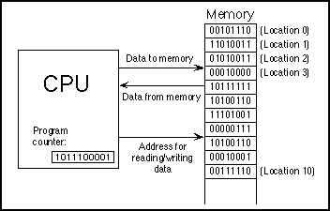
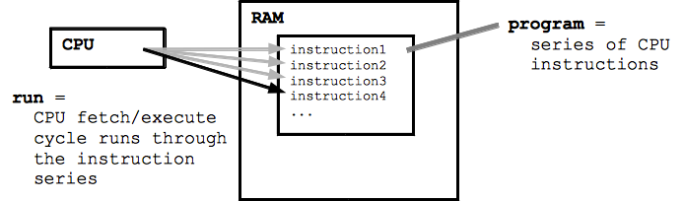
CPU and Memory Organization

Slide 6
Why do (simple) computers work this way?
An analogy about getting to know each person’s names in this room.
Easily scalable.
Standard.

Slide 7
Do we have to perform serial computation?
Short answer, no.
Long answer, maybe. Let me explain with an example.
int loopadd (int a, int b, int itr) {
int sum = 0;
for (int i=0; i <= itr; i++) {
sum = a + b;
}
return sum;
}
Loop?

Slide 8
Is this the same?
for (int i=0; i <= itr; i++) {
sum = a + b;
}
sum = a + b;
sum = a + b;
sum = a + b;
sum = a + b;
sum = a + b;
Assuming itr = 5
The loop is broken down this way.
Can we run these add operations in concurrently/parallel maybe??
What is concurrent or parallel computation then?

Slide 9
Concurrent and Parallel computation
Parallel computation (Explicit parallelism) is performing computation on multiple computers or “cores” simultaneously. (Usually from the same program and data memory spaces).
Analogy: A group of sous chefs cooking many meals.
Concurrent computation (implicit parallelism) is performing two operations “simultaneously” (simulating simultaneous execution) by using a single core, and sharing the resources and time for a specific part of the program in the memory space.
Analogy: One person cooking two meals.

Slide 10
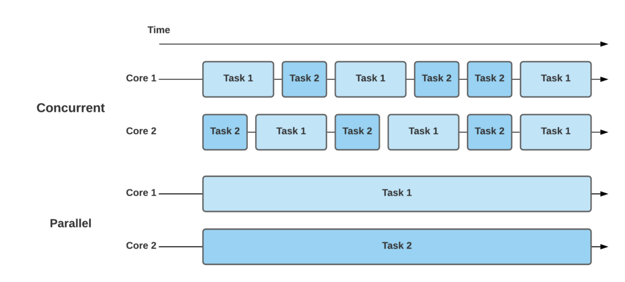
So, what does this reflect in terms of computation?
How can we maximize the efficiency of a computer?
Threads and atomic operations.

Slide 11
So, what is the concern?
When a core is performing two concurrent tasks, how do we deal with erroneous behavior? Since we are using shared resources (the same core to perform both tasks) (Example of RAW hazard)
Parts of the program that may cause this issue with errors are known as critical sections.
At critical sections, the core needed to be aware of protecting certain resources, and performing mutually exclusive execution and memory accesses.

Slide 12
Well, how does this information link with CUDA?
CUDA programming allows users to program a GPU device to compute a large set of data.
CUDA employs both concurrency and parallelism.
Understanding and identifying critical sections in the program allows the programmer to understand the best way to program the device using CUDA.

Slide 13
endmodule
Website: skudlur.github.com
Twitter: @s_kudlur
GitHub: @skudlur

